Slide 1



Let’s learn about satellites!
Satellite communication System
Space mission and satellite design course

Slide 2
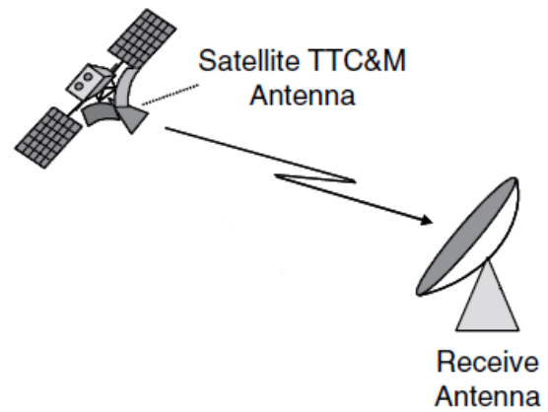
Telecommunication
The telecommunications system is critical for any space mission.
Without a communication link, the spacecraft would simply become a very expensive piece of debris, as no telemetry, commands, or mission data could be exchanged with the ground.

Slide 3
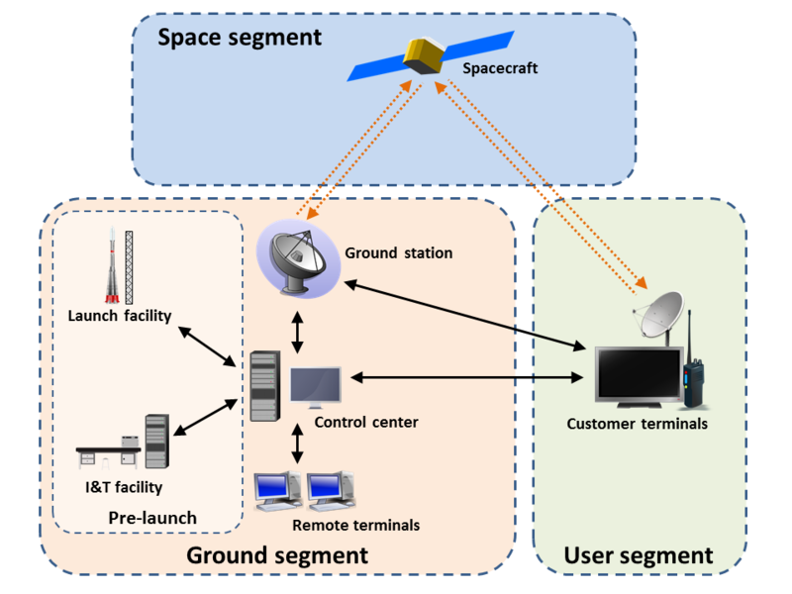
Segments of a space mission
A space mission is divided into three main segments:
Space Segment - the spacecraft and all onboard subsystems.
Ground Segment - ground stations, control centers, and communication infrastructure.
User Segment - the final users who receive and exploit mission data.
The telecommunication system connects all three segments into a single operational chain.
Notes:
Una mission è composta dallo space segment che comprende il satellite. Abbiamo il ground segment che comprende le ground stations, la mission control room ed eventualmente altre infrastrutture per la gestione ed analisi dei dati missione. Infine abbiamo lo user segment che comprende i clienti, la loro gestione e tutta l'infrastruttura per dare a loro i dati per cui hanno pagato

Slide 4
Why do we communicate?
Satellite communications serve four primary purposes:
Telemetry The spacecraft sends health and status data to monitor subsystem performance.
Telecommands The ground segment sends commands to control and operate the spacecraft.
Tracking Radio signals allow the determination of spacecraft position and velocity.
Payload Data Scientific or commercial mission data is transmitted back to Earth.
Without these functions, mission objectives cannot be achieved.
Notes:
La comunicazione può avvenire per questi 4 motivi

Slide 5
Mission data size
How much data generates each part of the mission?
Telemetry: typically ranges between bytes and kbytes
Commands: typically ranges between bytes and Mbytes
Payload: typically ranges between kbytes and Tbytes

Slide 6
Mission example
Let’s take, for instance, a 1U mission which has a 4MP payload camera.
We take 150 photos a day.
The telemetry parameters are read one time every 5 seconds
This simple scenario already highlights how payload quickly dominates total data generation.

Slide 7
Mission example - 2
Example telemetry data per packet:
Position (X,Y,Z): 24 bytes
Attitude (X,Y,Z): 24 bytes
10 temperature sensors: 10 bytes
10 voltage sensors: 10 bytes
10 current sensors: 10 bytes
64 digital status variables: 8 bytes
20 additional parameters: 80 bytes
Total per packet: 166 bytes
Sampling every 5 seconds results in approximately:
≈ 2.8 MB per day
Telemetry is relatively small compared to payload.

Slide 8
Mission example - 3
A 4 MP image produces:
4 million pixels × 3 bytes/pixel ≈ 12 MB per image
With lossless compression (2:1):
≈ 6 MB per image
150 images/day:
≈ 900 MB per day
Payload data is three orders of magnitude larger than telemetry.

Slide 9
Mission example - 4
Daily data:
Telemetry: 2.8 MB Payload: 900 MB
Telemetry represents only 0.32% of total data.
This example tells us that, almost every time, the design driver of the telecommunication system is the payload.

Slide 10
Telecommunication System Design
Designing a satellite communication system requires:
Definition of mission requirements
Architecture definition (number and type of ground stations)
Required data rate (bps)
Link budget analysis
Component selection
Every decision is driven by mission constraints and performance targets.

Slide 11
Telecommunication Design Requirements
The main design requirements are:
Data Volume Total amount of data to transmit and receive per day or per pass.
Timing and Coverage When communication is needed and for how long. This includes orbit type, ground station visibility, and uplink/downlink frequency selection.
Link Quality Required availability, reliability, and acceptable Bit Error Rate (BER).
Main limitations include
• Technical constraints (power, mass, antenna size) • Environmental constraints (atmospheric losses, radiation) • International regulations (frequency allocation, licensing)

Slide 12
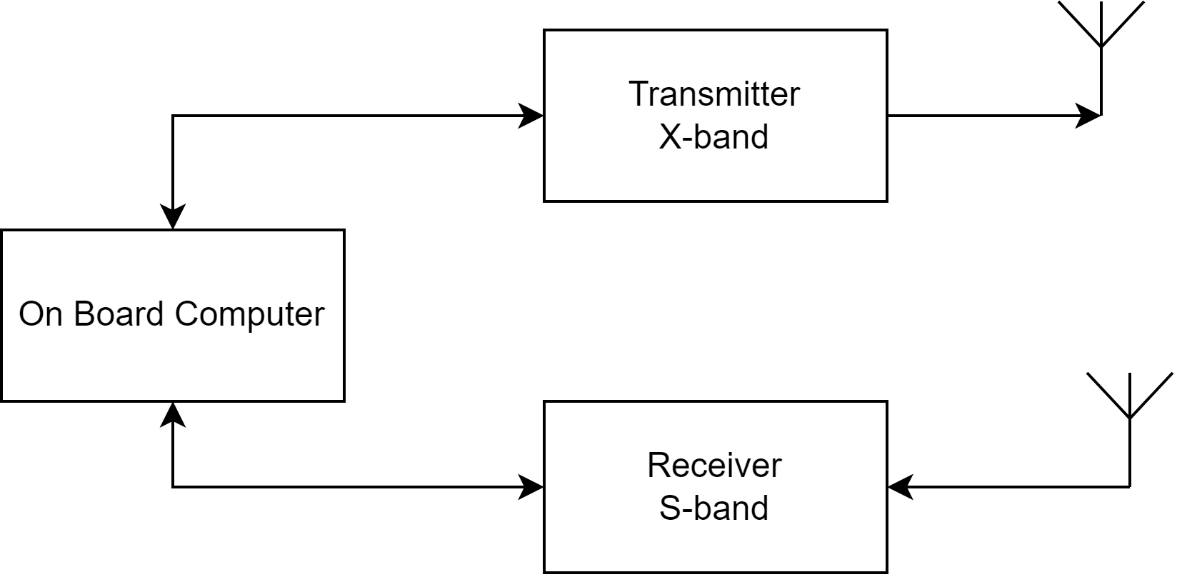
Telecommunication System in the Spacecraft
The telecommunication subsystem interfaces with:

Slide 13
Frequencies
 | Band
VHF | 30 - 300 MHz | Typically used by missions with low data volume or for telemetry downlink
UHF | 300 - 1000 MHz
L | 1 - 2 GHz | Used for high data rate missions
S | 2 - 4 GHz
C | 4 - 8 GHz
X | 8 - 12 GHz | Used for very high data rate missions.
Ku | 12 - 18 GHz
K | 18 - 27 GHz
Ka | 27 - 40 GHz

Slide 14
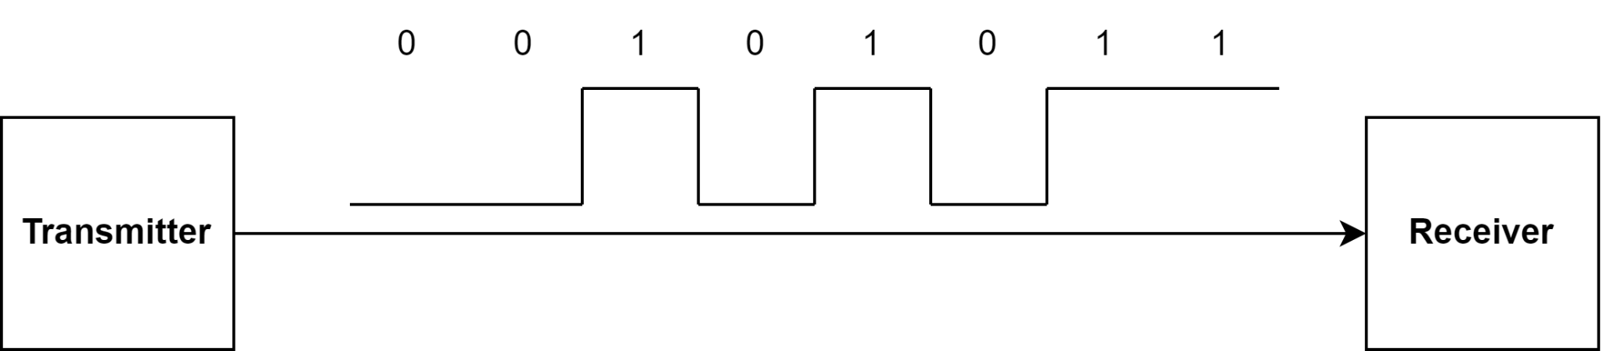
Digital data transmission
Almost every data is now transmitted in digital form. This means that we have to transmit only ones or zeros.
This informations can be interpreted electrically by different voltages.
We represent a 1 using 5V and we represent a 0 using 0V.
These digital signals are processed and then modulated onto a carrier wave for transmission.

Slide 15
Modulation
To transmit digital data wirelessly, we combine:
A digital signal
A high-frequency carrier wave
The result is a modulated signal.
Main modulation types:
ASK (Amplitude Shift Keying) FSK (Frequency Shift Keying) PSK (Phase Shift Keying)
Each method encodes digital data differently onto the carrier.

Slide 16
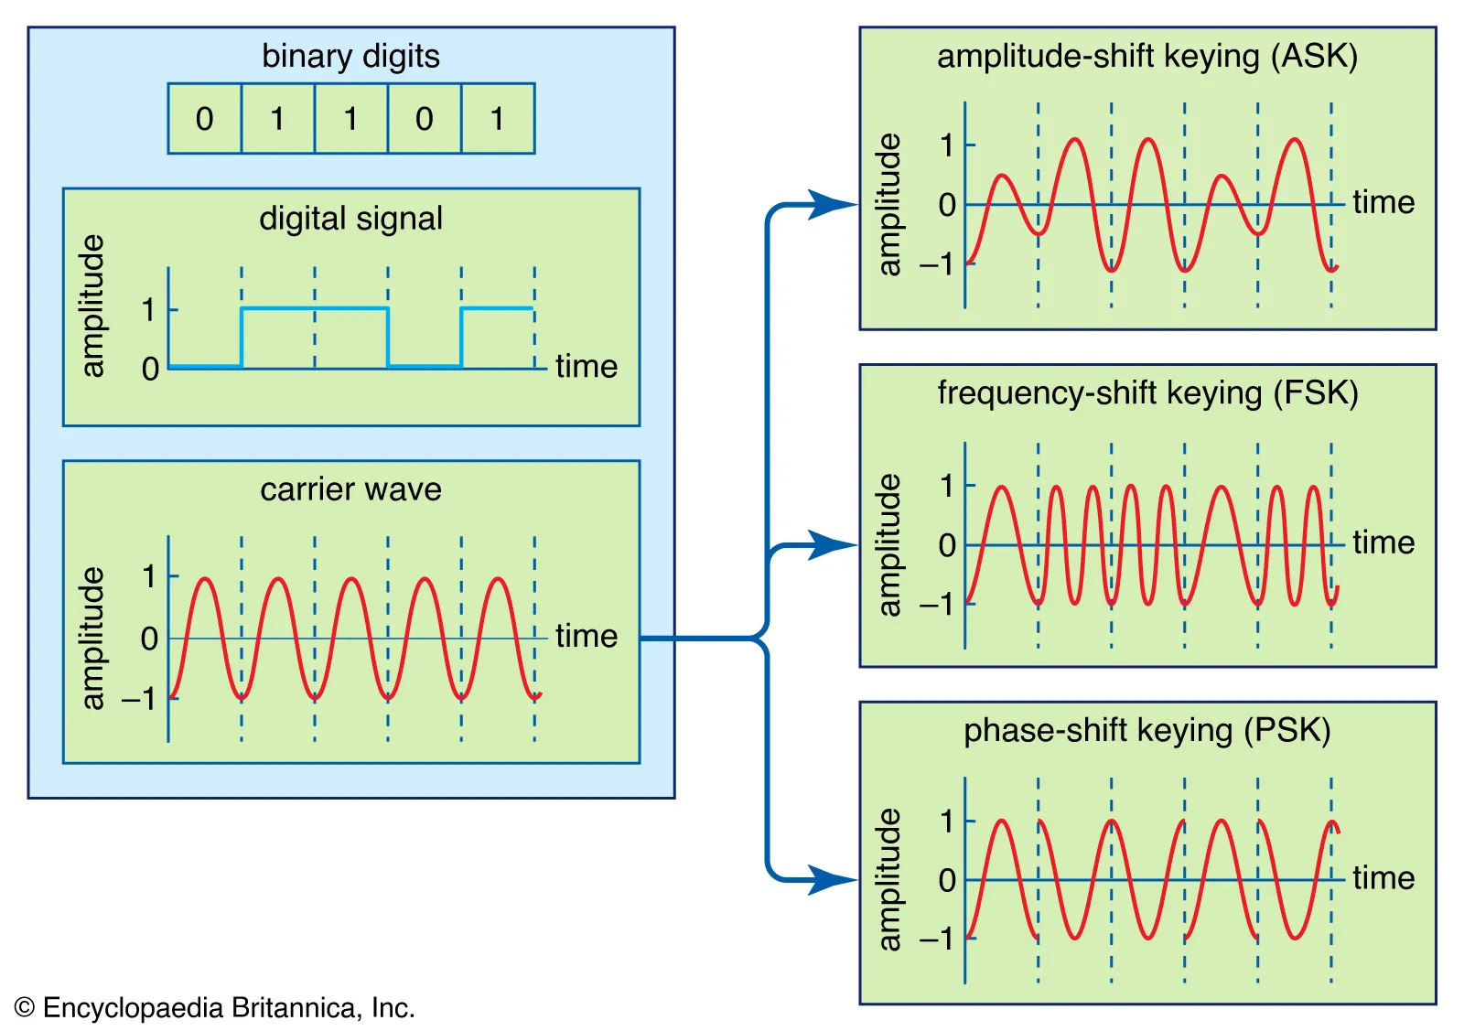
Modulation (Visual)

Slide 17
Why Modulation Matters
The choice of modulation affects:
Bandwidth Higher data rates require larger bandwidth.
Noise Resistance Some modulation schemes are more robust against channel noise.
Complexity More advanced schemes require more complex hardware and signal processing.
Trade-offs must be evaluated based on mission requirements.

Slide 18
Antennas
The antenna transmits and receives electromagnetic waves.
Key antenna parameters:
Gain Indicates directionality and signal amplification.
Central Frequency Frequency at which the antenna is optimized.
Bandwidth Frequency range over which it operates efficiently.
Radiation Pattern Spatial distribution of transmitted power.
Polarization Orientation of the electric field.

Slide 19
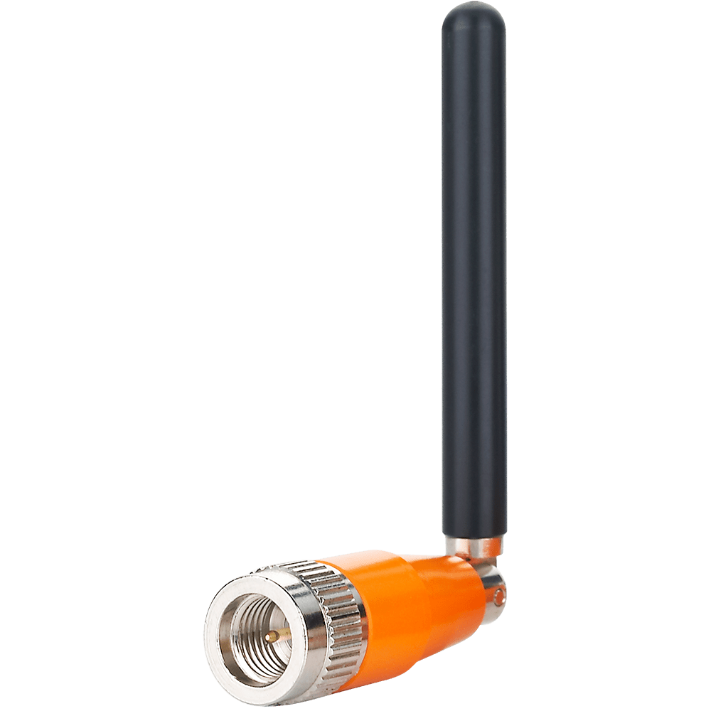
Monopole antenna
A monopole antenna is an omnidirectional antenna commonly used in low-frequency CubeSat missions.
Key characteristics:
• Nearly uniform radiation in all horizontal directions • Typical gain ≈ 0 dBi • Simple design and lightweight

Slide 20
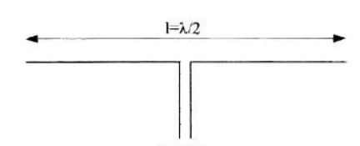
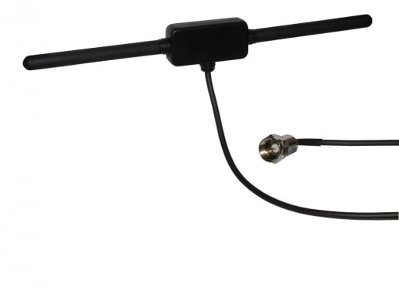
Dipole antenna
A dipole antenna consists of two conductive elements.
Key properties:
• Theoretical gain ≈ 2.15 dBi • Omnidirectional in the plane perpendicular to the elements • Null radiation along the axis of the antenna

Slide 21
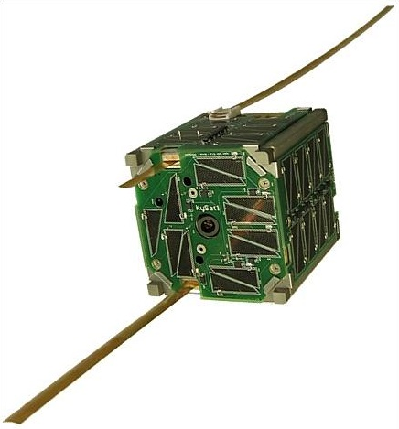
CubeSat Dipole Antenna
KySat-1

Slide 22
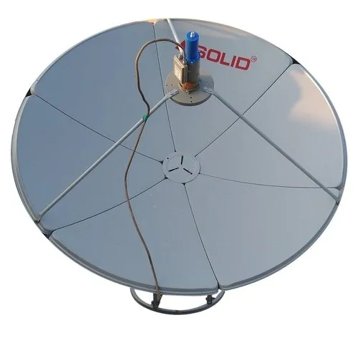
Parabolic antenna
Parabolic antennas are high-gain, highly directional antennas.
They are typically used at frequencies above 2 GHz.
Gain depends on:
• Frequency • Reflector diameter
The gain increases with both higher frequency and larger diameter.
Parabolic antennas are commonly used in ground stations and deep-space communication.

Slide 23
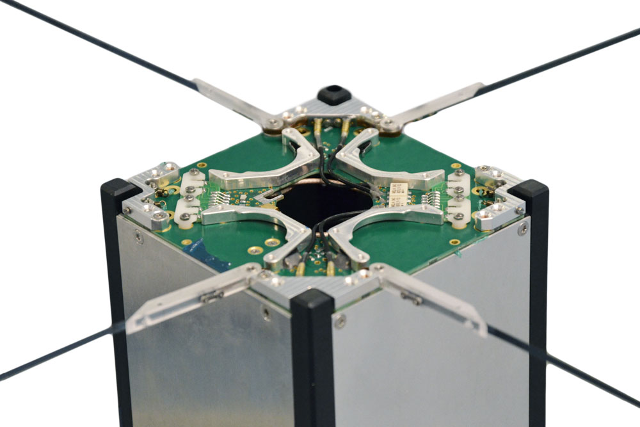
CubeSat Turnstile Antenna
A turnstile antenna consists of two dipoles arranged orthogonally.
Main advantage is the circular polarization.
Circular polarization that improves:
•Resistance to polarization mismatch • Robustness to satellite rotation
This is particularly useful in LEO missions where spacecraft attitude varies.

Slide 24
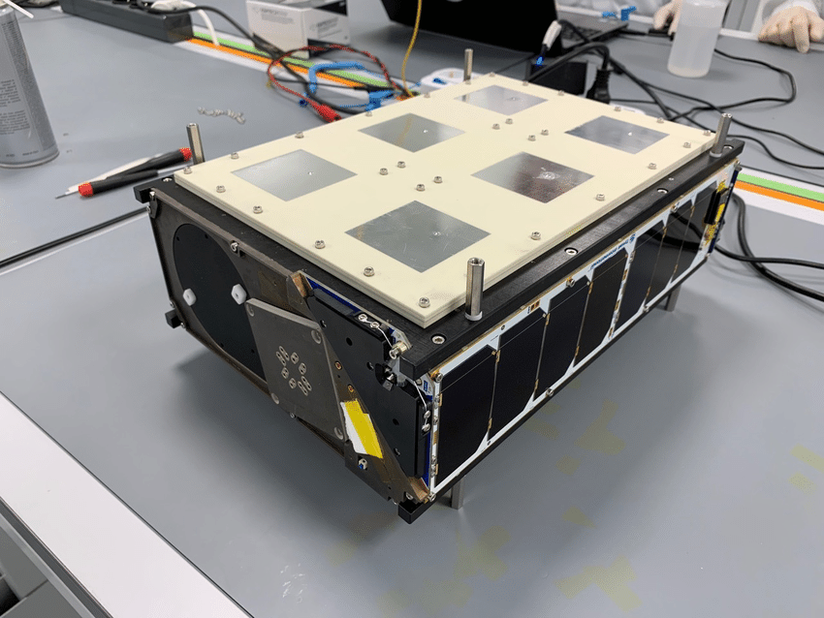
CubeSat Patch Antenna
Patch antennas are planar, compact antennas used at higher frequencies.
Characteristics:
• High frequency operation (S-band, X-band, Ka-band)
• Higher gain compared to monopoles/dipoles
• Directional radiation pattern
Often integrated directly into spacecraft solar panels.

Slide 25
Antennas Are Not Enough
An antenna alone cannot transmit or receive meaningful information.
The antenna is only the interface between the spacecraft and free space: it converts electrical signals into electromagnetic waves (and vice versa).
To actually communicate, we need a radio system that:
• Generates the carrier frequency • Modulates digital data onto the carrier • Amplifies the signal before transmission • Receives weak incoming signals • Demodulates and decodes the data
This complete system is called a transceiver (transmitter + receiver).

Slide 26
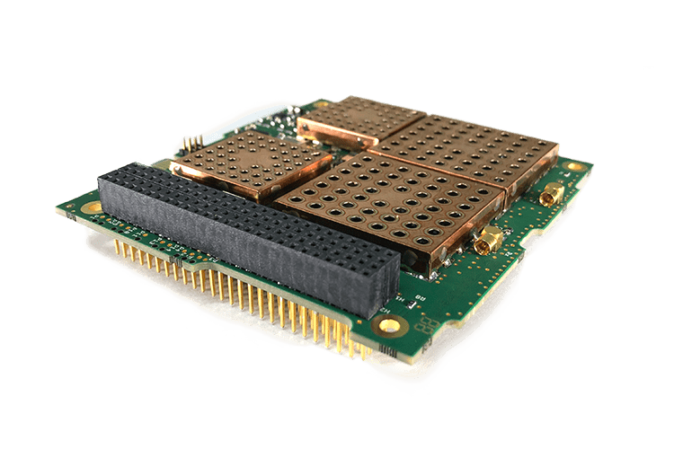
The CubeSat Transceiver
A CubeSat transceiver is the electronic subsystem that enables communication.
It typically includes:
Baseband Processing
Frequency Generation
Power Amplifier (PA)
Low Noise Amplifier (LNA)
RF Filtering and Switching
The antenna radiates the signal, but the transceiver creates, processes, and interprets it.

Slide 27
Common CubeSat Radio Types
UHF (300–1000 MHz) Most common for CubeSats: TT&C, low data rate, larger antennas, robust links.
VHF (30–300 MHz) Very robust but very low data rate; mainly for simple uplinks/legacy missions.
S-band (2–4 GHz) Medium data rate, smaller antennas; common for payload-driven LEO missions.
X-band (8–12 GHz) High data rate downlink; requires directional antennas and good pointing.
SDR (Software Defined Radio) Flexible radio where modulation/data rate (and sometimes bands) can be reconfigured in software.

